Slide 1
Looking Beyond Our Borders: What Therapeutic Residential Care in Other Countries can Teach Us
ACRC International Therapeutic Residential Care Summit
KEYNOTE
5 November 2020

Slide 2
INTRODUCING OURSELVES
Prof. Dr. Sigrid James
University of Kassel
Department of Social Work & Social Welfare
Kassel, Germany
Email: sigrid.james@uni-kassel.de
Prof. Dr. Bethany Lee
University of Maryland
School of Social Work
Baltimore, MD, USA
Email: blee@ssw.umaryland.edu

Slide 3
What we will cover
Introduction – TRC terminology and landscape
Mapping cross-country differences of TRC – an ERASMUS project
The macro context
Characteristics of children and youth
Residential care personnel and training
Key takeaways

Slide 4
TRC Definition: orIGINAL
“Therapeutic residential care’ involves the planful use of a purposefully constructed, multi-dimensional living environment designed to enhance or provide treatment, education, socialization, support, and protection to children and youth with identified mental health or behavioral needs in partnership with their families and in collaboration with a full spectrum of community-based formal and informal helping resources” (Whittaker, del Valle, & Holmes, 2014, p. 24).

Slide 5
TRC Definition
“Therapeutic residential care’ involves the planful use of a purposefully constructed, multi-dimensional living environment designed to enhance or provide treatment, education, socialization, support, and protection to children and youth with identified mental health or behavioral needs in partnership with their families and in collaboration with a full spectrum of community-based formal and informal helping resources” (Whittaker, del Valle, & Holmes, 2014, p. 24).
Most (T)RC programs do these things

Slide 6
TRC Definition
“Therapeutic residential care’ involves the planful use of a purposefully constructed, multi-dimensional living environment designed to enhance or provide treatment, education, socialization, support, and protection to children and youth with identified mental health or behavioral needs in partnership with their families and in collaboration with a full spectrum of community-based formal and informal helping resources” (Whittaker, del Valle, & Holmes, 2014, p. 24).
Most treatment-focused programs do these things

Slide 7
TRC Definition
“Therapeutic residential care’ involves the planful use of a purposefully constructed, multi-dimensional living environment designed to enhance or provide treatment, education, socialization, support, and protection to children and youth with identified mental health or behavioral needs in partnership with their families and in collaboration with a full spectrum of community-based formal and informal helping resources” (Whittaker, del Valle, & Holmes, 2014, p. 24).
Many programs set these as ideals but not always attain

Slide 8
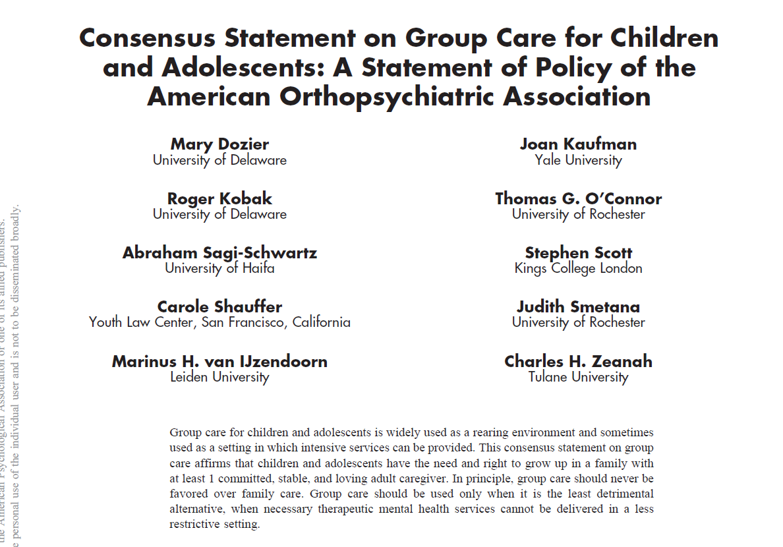
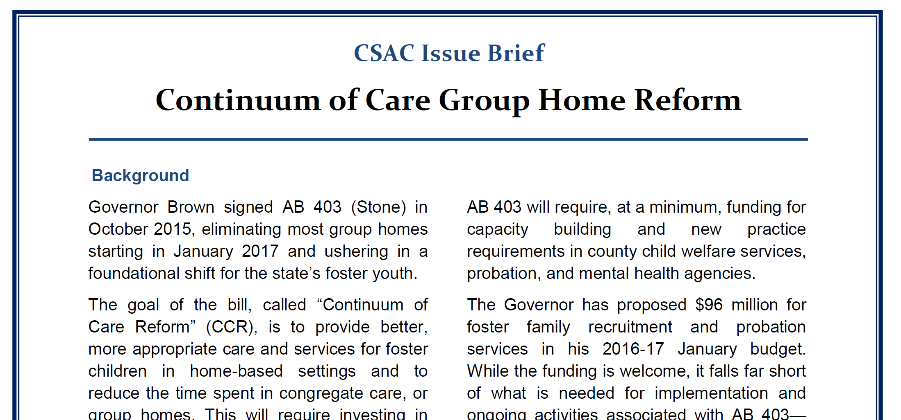
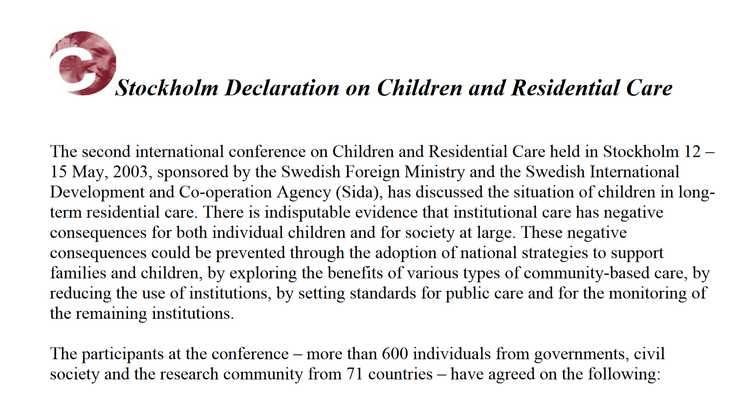
(T)RC – a fading intervention?

Slide 9
CONSEQUENCES
Various policy initiatives to reduce RC
Documented reductions in RC use
RC as short-term or stop-gap option
Growth of community- and family-based alternatives
Increased clinical severity of youth in RC
Closure and/or diversification of RC programs

Slide 10
YET... CONSIDERABLE Cross-Country Differences in the Utilization of Residential / Group Care
Fin
land
38%
USA
10%
Italy
50%
Portugal
97%
0%
50%
100%
Australia 5%
Lithuania
23%
Germany
55%
Japan
92%
England
9%
Sweden
27%
Spain
52%
Israel
80%
Ainsworth, F. & Thoburn, J. (2014). An exploration of the differential usage of residential childcare across national boundaries. Int J Soc Welfare 23, 16-24.

Slide 11
ERASMUS PROJECT “Empowering Residential Child Care through Interprofessional Training” (2018-2021)
Project partners: Finland, Italy, Lithuania, Spain, Germany
AIMS
To understand differences in the use and function of RC in the partner countries
To understand needed competencies, qualifications and training for RC personnel across countries
To create an evidence-based teaching module to foster needed competencies
To disseminate and evaluate the use of teaching module

Slide 12
Toward meaningful comparisons
Macro context
(CW history, policies, etc.)
RC system and program features
# of youth in OOHC
RC utilization rate
# and types of programs
Average number of youth in programs
Auspices(private/public)
Primary RC models
Careleaver & aftercare services
Parent/family services
Cost per night
Quality standards
Major current issues
RC training and personnel
Required education/degree
Length of training
Curriculum content on RC
Worker-youth ratio
Frequency of case reports
Salary in relation to national average
CONTEXT
UNITS OF ANALYSIS
VARIABLES
Characteristics
of youth
Gender ratio
Age categories
Average age at entry
% of youth with migration background
Number of UMRs
Rate of MH problems
% of single-parent families
Average length of stay
Primary reason for entry into RC

Slide 13
Data collection process
Development of a matrix capturing analytic categories (deductive and inductive process)
“Data collection” by each team between April and July 2019: government reports, administrative data, research studies, relevant websites, etc.
Analysis of data – cross-case synthesis and pattern-matching (intra and inter comparisons)

Slide 14
MACRO CONTEXT
Finland
Germany
Italy
social democratic welfare state; shift toward a child- and family-centered (preventive) approach, ratified in Child Welfare Act of 2007; foster care preferred over residential care; OOHC as a last resort; yet, comparatively high OOHC rates per 1000 children
first social welfare system; long and noted history of RC and pedagogical traditions; favors RC over family-based options; major RC reforms following scandals and anti-authoritarian movement in the 1960s and 70s
long history of institutionalization based on religious and cultural traditions; reluctance to remove children; cultural preference for residential over foster care yet policy promotes foster care; since 2001 closure of large residential facilities
Lithuania
Spain
strong institutional care traditions inherited from the Soviet system; since gaining independence in 1990, major child welfare reforms; 2014 strategic plan to speed up institutionalization; since then establishment of smaller group homes
long history of institutionalization based on religious and historical traditions; reforms in 1990s toward more family-based options and smaller RC programs; greater decentralization

Slide 15
Residential Care System and Features
 | FINLAND | GERMANY | ITALY | LITHUANIA | SPAIN
OOHC rate per 1000
% of children in RC vs. FC
Utilization trends
Number and types of RC
Service system (CW, MH, JJ, etc.)
Auspices (private/public)
# of children per program
Parent/family involvement
Careleaver program
Primary conceptual model
Stated aims of RC
Cost per night / funding
Quality standards
Perceived strengths & deficits
Major current issues

Slide 16
Placement and RC Proportion
What % of OOHC are RC?
Line shows rate of OOHC per 1000 youth

Slide 17
AUSPICES & PRIMARY CONCEPTUAL MODEL
Finland
Germany
Italy
Lithuania
Spain
AUSPICES
CONCEPTUAL MODEL
strong pedagogical, milieu-based, community orientation (part. Germany & Italy)
primarily
private /
nonpublic
augmented by systemic, behavioral, trauma-informed concepts / some EBPs (part. Spain & Finland)

Slide 18
Family involvement & Careleaver Programs
Agreement that both elements are important; increasingly, captured in policy
and defined as a standard; however, significant variability in implementation
GERMANY – possible until age 24 or 27 if indicated (but rare)
FINLAND – guarantees transition support until age 25
LITHUANIA – possible until age 24 if receiving formal education
CARELEAVER SERVICES
SPAIN – possible until age 23
ITALY
Age 21
Age 23
Age 25
Age 27

Slide 19
US Comparison: Macro System
Focusing on Child Welfare:
As of 2018, we have 437, 283 youth in out-of-home care.
6 youth in OOHC per 1,000 minors.
Number in RC Placements
US DHHS (2019). The AFCARS Report. Preliminary Estimates for FY 2018 as of August 22, 2019 (26). https://www.acf.hhs.gov/cb
AFCARS data and US Census Bureau data compiled by KidsCount (Annie E. Casey Foundation). https://datacenter.kidscount.org/data/tables/6242-children-0-to-17-in-foster-care#detailed/1/any/false/37,871,870,573,869,36,868,867,133,38/any/12985,20455
AFCARS Reports #22-26.

Slide 20
US Comparison: Macro System
But this is only Child Welfare!
Focusing on Child Welfare:
As of 2018, we have 437, 283 youth in out-of-home care.
6 youth in OOHC per 1,000 minors.
311,000 children and adolescents lived in residential treatment (RT) facilities to treat severe mental health and behavioral health disorders (Center for Behavioral Health Statistics and Quality, 2018)
US DHHS (2019). The AFCARS Report. Preliminary Estimates for FY 2018 as of August 22, 2019 (26). https://www.acf.hhs.gov/cb
AFCARS data and US Census Bureau data compiled by KidsCount (Annie E. Casey Foundation). https://datacenter.kidscount.org/data/tables/6242-children-0-to-17-in-foster-care#detailed/1/any/false/37,871,870,573,869,36,868,867,133,38/any/12985,20455
AFCARS Reports #22-26.

Slide 21
US Macro System Limitations
Child Welfare
Separate systems challenge knowledge of:
Average cost per day/stay;
Number/type of programs;
Number of kids/program;
Agency type: public, private, non-profit, for-profit;
Aims of (T)RC;
Average length of stay;
Primary concepts/theories;
Also, states vary in policy/regulation and little national guidance
Juvenile Justice
Behavioral Health
Education
Private Insurance

Slide 22
US (t)RC Program features
Conceptual Model: Evidence-Based Practice?
88% of ACRC programs reported using at least one EBP*
56% reported using 3 or more practices
No national quality standards, some state policies.
Structured program model may be indicator of program quality (Farmer et al., 2017)
Accreditation is becoming more commonly required (for QRTP but also in some states), but no empirical evidence to support accreditation as a necessary/sufficient quality standard;
*James, S., Thompson, R., Sternberg, N., Schnur, E., Ross, J., Butler, L., & Muirhead, J. (2015). Attitudes, perceptions, and utilization of evidence-based practices in residential care. Residential Treatment for Children & Youth, 32, 144-166.

Slide 23
US (t)RC Program features
Extended Foster Care (providing supports to older youth/ careleavers) beyond 18 is active in 46 states*;
Aftercare is increasingly understood as important, but inconsistently funded/required (other than QRTPs);
*Child Welfare Information Gateway (2017). Extension of Foster Care Beyond Age 18. Available: https://www.childwelfare.gov/topics/systemwide/laws-policies/statutes/extensionfc/

Slide 24
Characteristics of Youth
 | FINLAND | GERMANY | ITALY | LITHUANIA | SPAIN
Gender ratio (m/f)
Average age/age categories
Average age at entry into RC
% of youth in RC w/ a migration background
Number of UMRs
Rate of mental health problems
% of single parent families
Primary reason for entry into RC
Average length of stay

Slide 25
Gender Ratio & % of YOUTH WITH MIGRATION BACKGROUND
GENDER RATIO
MIGRATION BACKGROUND IN RC
no data available
53.3%
24.7%
no data available
55.0%
not officially counted

Slide 26
Age Distribution in RC / % of young children

Slide 27
A few more datapoints …
FINLAND
GERMANY
ITALY
LITHUANIA
SPAIN
Rate of MH problems
30-80%
57.1%
met criteria for 1 or more ICD10-F dx
no data
150 children in RC with a psychiatric dx
61%
meeting clinical criteria / CBCL
Length
of stay
48 months
17 months
<3mos: 14.5%
3-12mos: 31%
12-24mos: 22.7%
24-48mos: 17.2%
>48mos: 14.5%
no data
42.6 months
Primary reason for entry
Parental exhaustion: 58%
Parenting problems: 50%
Family conflict: 49%
Parental coping with daily life: 32%
Domestic violence: 23%
Youth MH problems: 37%
Living arrangements w/ neg effect: 10%
Limited parenting competence
Child engangerment:
Insufficient support of child
Youth behavior problems
Family conflict
Developmental problems
Educational problems
Problems in parenting
Family relational problems
Family violence
Child abuse and neglect: 75%
Child abuse and neglect: 61.8%
Unaccompanied migrant status has become a primary reason for entry
Notes:
.

Slide 28
US Youth In (T)RC
What we believe to be true of youth in (T)RC in US:
More males than females
Older youth (most over 12 years old)
Some TRC placement for Unaccompanied Minors, but not systematically measured;
Efforts to reduce length of stay (under 1 year);
(Very/increasingly) High rates of mental health need:
Most TRCs are treatment-oriented for mental health needs, trauma, etc.
TRC placement sometimes requires meeting “medical necessity” criteria;
High rates of psychotropic medication usage

Slide 29
RC Training & Personnel
 | FINLAND | GERMANY | ITALY | LITHUANIA | SPAIN
Educational requirements
RC Team composition
Length of training
Worker:Youth ratio
Turnover rate
Frequency of case reports
Salary (compared to national average)

Slide 30
Educational requirements for RC workerS
Finland
2-3yr vocational training in social or health care (Care worker)
Germany
5yr vocational training as Educator
Italy
3yr BA in Educational Sciences
Lithuania
Spain
3.5yrs BA in social services or nursing (counselor)
main SW in CW (MA degree)
3-3.5yrs BA in Social Work or Social Pedagogy
Social Assistants with 2yr vocational training may also be part of a RC team
4yr BA in Social Work
SW assistants with special training courses
4yr BA Social Education
2yr vocational training as a Technical Educational Asst.

Slide 31
US (t)RC Training and Personnel
No national standards for staff training, staff-youth ratios, or salary;
Some individual states and accrediting bodies provide guidance;
MD: Child and Youth Care Practitioner 21-credit certificate program;
CA: Child and Youth Care Certification Exam at 3 levels: Entry, Associate, Professional;
No national record-keeping on (T)RC Staffing

Slide 32
POLICY PRIORITIES & MAJOR CURRENT CHALLENGES
FINLAND
Privatization
Quality monitoring
GERMANY
UMRs
‘system breakers’ and ‘closed RCs’
ITALY
Deinstitution-alization
LITHUANIA
Deinstitution-alization
Lack of skilled RC workers resulting in premature transfers to specialists
SPAIN
UMR/Ms
Preventive services insufficient to reduce RC placement
High turnover of RC personnel
Predominant use of RC
Uneven data collection
Ambiguous classification of RC
Many untested concepts and methods
High turnover
Insufficient attention paid to bio family
Lack of integration with other systems
Lack of integration with MH system
Quality monitoring
Challenging profiles of youth
Insufficient family involvement

Slide 33
(SOME) INSIGHTS FROM THE ERASMUS PROJECT
Confounding terminology; RC ≠ RC;
RC fulfills still care and accommodation functions
While deinstitutionalization efforts and emphasis of family-based options is apparent everywhere, different countries are in different stages
Family-based alternatives confront significant cultural conceptual & structural barriers in some countries
Surprisingly high rates of young children in RCs and comparatively long stays in RC
Agreement (in theory) on some program elements, e.g. parent involvement, transition support/careleaver programs, but difficulties implementing these elements; also considerable regional variability
No dominant conceptual models but strong pedagogical traditions in some countries
Different degree requirements for RC workers but signs of professionalization

Slide 34
Learning from Each other
(SOME) COMMONALITIES
High-risk status of RC youth (high rate of MH problems confirmed across countries)
Consensus on importance of core program elements (e.g., family involvement, aftercare/ careleavers) - but how to best implement?
General emphasis on family-based care but struggle to find the right balance between RC and FC
Staff turnover and low salary for RC workers are challenges across countries
WHAT EU CAN TEACH US
RC can be more than a stop-gap option & has more than a treatment function
RC can take many different forms (small family-like group homes, supported living)
EBP yes, but the importance of a pedagogical/ therapeutic milieu
The need for a professionalized RC workforce
National quality standards
What US can teach EU
How to create more family-based alternatives
More awareness of clinical issues and need for approaches
Family voice and family-driven organizations
Good concepts/ theory aren’t enough; need to be tested with data; greater integration of EBPs
Need for more data and outcomes research

Slide 35
We welcome your Comments & Questions!
Prof. Dr. Sigrid James
Email: sigrid.james@uni-kassel.de
Prof. Dr. Bethany Lee
Email: blee@ssw.umaryland.edu
ACKNOWLEDGMENT: I want to recognize my ERASMUS partners who have collected data on residential care for their countries and are co-authors on a paper in preparation about the cross-national comparisons (S. James):
Eeva Timonen-Kallio (PI) & Tiina Pelander (Turku University of Applied Sciences, Finland)
Jorge F. del Valle & Amaia Bravo (University of Oviedo, Spain)
Jolanta Pivoriene & Alina Petrauskiene (Mykolas Romeris University, Lithuania)
Laura Fermenti & Alessandra Rigamonti (University of Milano-Bicocca, Italy)
Juri Kilian & Lucas Wilczek (University of Kassel, Germany)

